Slide 1
TRAUMA & THE REFUGEE
Brain and Behavior Effects and Responses
©Josette Kehl, LCSW, TBRI® Practitioner, 2020

Slide 2
Trauma Overview
What is it?
Characteristics
Acute: a single event
Chronic: repeated and prolonged
Complex: varied and multiple events of an invasive & interpersonal nature
Natural disaster, accident, rape
Domestic violence, ongoing abuse, chronic medical
Chronic child physical or sexual abuse, severe neglect, abduction

Slide 3
Types of Trauma
Big T trauma
War, genocide, murder, armed robbery, chronic physical or sexual abuse, rape
Little T trauma
Emotional abuse, neglect, ongoing medical issues, having a parent or spouse with substance abuse problem, homelessness
Big t: obvious, noticeable, “big”
Little t: less obvious/noticeable, can still “add up”

Slide 4
Trauma and Refugees
What kinds of trauma do refugees experience?
Examples
Mother experienced tremendous stress during pregnancy
Difficult/traumatic birth; early medial intervention; extended hospitalization
Domestic violence
Being primary caregiver for siblings at a young age
Death/disappearance of family member
Serious bodily injury/loss of limb/mutilation/burn
Life threatening or chronic medical issues
Rape
War, bombings, witnessing acts of violence
Natural disasters
Physical/sexual abuse
Removal from /loss of parents; change in care-givers
Inconsistent or harsh care-giving related to environmental or historical stressors
Loss of country/family/home/language (related to resettlement)
Discrimination/bullying in new home country

Slide 5
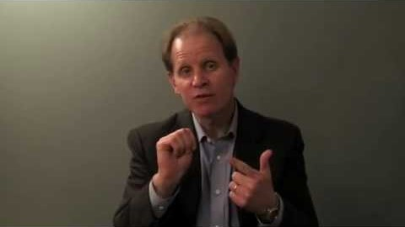
Results of Trauma
Distress, danger, imbalance, fear and uncertainty
Fight, flight or freeze
Hand model

Slide 6
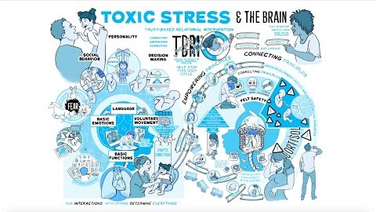
Results of Trauma
Attachment trauma
Toxic stress & the brain
Ongoing trauma

Slide 7
Results of Trauma
PTSD-like symptoms
Most common result of complex trauma in children
Dysregulation of emotions and impulses*
Different brain
You too?
Self awareness is key
Shaped by history
*Howard Bath, “Three Pillars of Trauma Informed Care”, 2008

Slide 8
Self-regulation
Interoception
Sense of what is going on in one’s own body
Hot/cold, hungry, thirsty, elimination, muscle tension
“Self regulation depends on having a friendly relationship with your body.” Dr. Bessel Van der Kolk, The Body Keeps the Score
Mindfulness
Breathing, meditation, movement
Redeeming the practices: meditation on God/Scripture
Intent: slow down, notice body/mind/thoughts, respond from calm vs. anger/fear

Slide 9
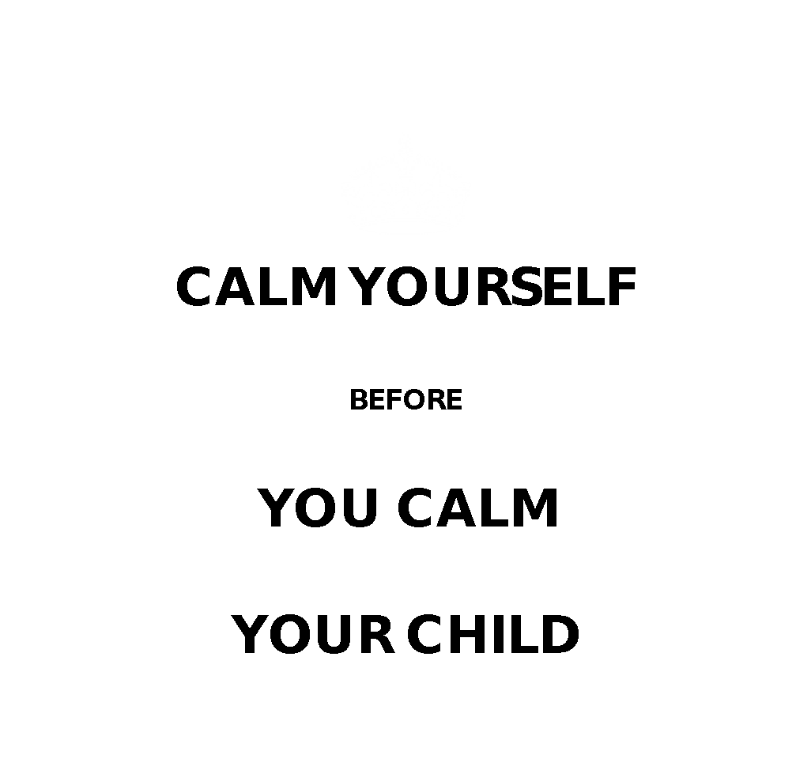
Self regulation
Kids will push buttons
Don’t join in their dysregulation
Tune into your own cues
Know when to walk away (and when to run ;)

Slide 10
Trauma Informed Care
3 pronged approach*
Felt safety (and children have a voice)
Connections with trusted adults
Skills to manage emotions and behaviors
*Howard Bath, “Three Pillars of Trauma Informed Care”, 2008

Slide 11
Empowering Principles from Trust Based Relational Intervention®
Routine
Transitions
Rituals
Artifacts
Choices
Movement
Blood sugar & hydration
Sensory seekers & sensory avoiders

Slide 12
Connecting Principles from TBRI®
Calm presence
Attunement
Behavior matching
Eye contact
Voice
Healthy touch

Slide 13
Correcting Principles from TBRI®
Life value terms
“with respect”, “use your words/words, please”, “gentle & kind/ease up”, “askin or tellin”, “no hurts”
Re-do’s
Choices
Compromises
Time-ins
“It’s not over til it’s over, but when it’s over, it’s over”

Slide 14
Levels of Engagement from TBRI®
4 leveled responses to defiance/misbehavior
Level 1: Playful engagement
Smaller infractions; disrespect; playful re-direction-’askin or tellin’
Level 2: Structured engagement
Child more defiant; pause situation, 2 choices, compromises, re-dos
Level 3: Calming engagement
Lid is flipped or almost flipped, child needs help regulating, time-in, give space
Level 4: Protective engagement
Flipped lid, violence/aggression; contain, minimize harm/destruction

Slide 15
Final Thoughts
Run-away protocol
All behavior is communicating something; if they can use words to communicate—it’s a win
Co-regulation
Balance of nurture and structure
Preciousness

